Slide 1
Outline Of Today’s Discussion
Trichromatic Vision

Slide 2
Part 1
Trichromatic Vision

Slide 3
Trichromatic Vision
The word “trichromatic” refers to three (tri) types of cone photopigments (chroma=color).
Trichromatic vision is the ONLY branch of science where the quality of human experience can be traced directly to a short DNA sequence on a single chromosome.
To appreciate what THREE cone photopigments can do, let’s first consider how we might experience color if we had just ONE or TWO photopigments….

Slide 4
Trichromatic Vision
An eye that contains just one type of photopigment would be considered “monochromatic” (mono=one), (chroma=color).

Slide 5
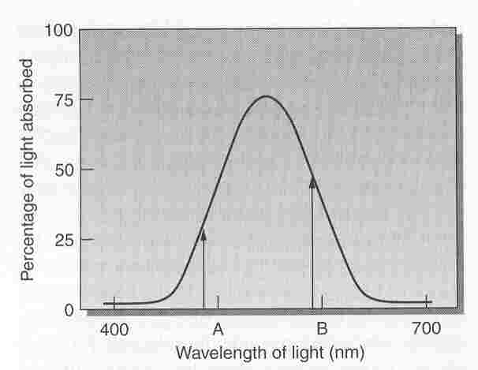
Trichromatic Vision
A One-Pigment System
This photopigment absorbs two times more light
at “B” than at “A” (50% versus 25%).

Slide 6
Trichromatic Vision
If lights “A” and “B” were presented at equal intensity, the response to “B” would be two times larger than to “A”.
However, the response to “A” and “B” could be made equal by doubling the intensity of light “A”.
For example, you could have 200 units of light at “A” (which would be 200 * 25% = 50 units of light absorbed) and 100 units of light at “B” (100 * 50% = 50 again).
Therefore, this one-pigment system can’t reliably distinguish changes in wavelength from changes in intensity. Therefore, it would generate metamers.

Slide 7
Trichromatic Vision
A person with a one-pigment system can’t discriminate wavelengths, and is called a monochromat.
To a monochromat, changes in light simply appear as various shades of gray.
Humans are monochromats in certain lighting (scotopic) conditions, because rods contain just one type of photopigment.
Now let’s consider a two-pigment system…

Slide 8
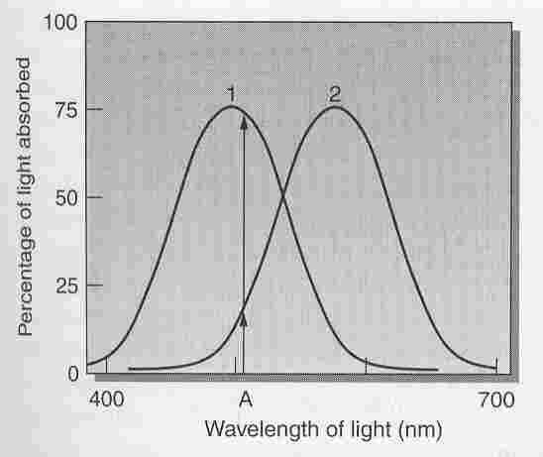
Trichromatic Vision
A Two-Pigment System
600
The PAIR of responses to “A” (Pigment 1 > Pigment 2) differs
from the PAIR of responses at 600 nm (Pigment 1 < Pigment 2).

Slide 9
Trichromatic Vision
Unlike a monochromat, a person with a two-pigment system CAN discriminate wavelengths, and is called a dichromat.
Except monkeys, apes, and humans –all mammals that are known to have more than one type of cone pigment are dichromats.
Your dog and your cat are dichromats!
Although dichromats are not color blind, dichcromats are very vulnerable to color metamers…

